Slide 1






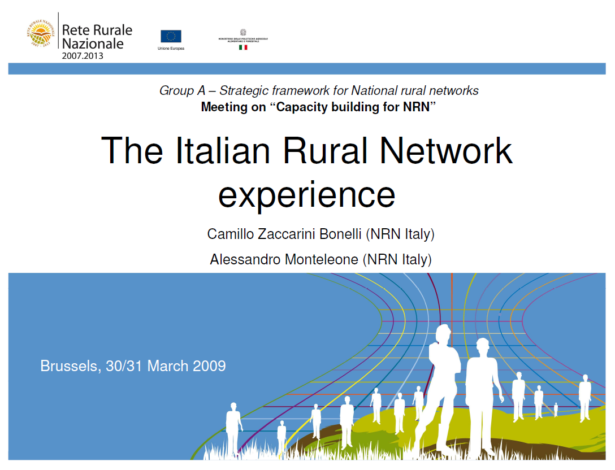
National Network of
Rural Areas
The Emilia Romagna Region experience
Roberto Gigante, NNR - Emilia Romagna
Wroclaw,
23-24th October 2009

Slide 2
Why the Rural Network was made?
Necessity to support the information process in order to fill up the dispersion of rural operators in the country
Presence of several subject very different from them (directly or indirectly) connected to the rural development.
Encourage the support of employments offer in order to reduce the abandoning process in the rural areas, in particularly of young people
Demand to satisfy specific necessity of different Italian regions
Increase the value of bests Italian rural areas, but at the same time come out possible critical situation of governance system
Roberto Gigante – I.N.E.A. – Emilia Romagna Region

Slide 3
The National Rural Network
All the states of European Community have to supply with a National Rural Network connected to the European one
The network have to perform differents duties:
  Detect and transfer best bractice (in the region, in the Country, and in Europe)
  Organize and exchange experiences
  Set formation programs
  In the large, the network have to know and spread the risult of the new policy of Rural Development
Roberto Gigante – I.N.E.A. – Emilia Romagna Region

Slide 4
Which is the strategy?
The analysis of critical situation and the require of intervention pull out three global objective that the Rural Network Program intend to follow:
1
2
Reinforcement of planning and management activity
3
Diffusion of best practice and knowledge
Improvement of governance
Roberto Gigante – I.N.E.A. – Emilia Romagna Region

Slide 5
The program of National Rural Network
For a country like Italy, characterize by a strong administrative decentralization system, but with a growing request of a bottom-up partecipation to the rural development, the decision to use the National Rural Network is base on:
Action system and support to the regional administrative services in order to help management of Rural Development Program and improve performance, efficiency, and integration with other policy
Specific actions to enforce planning and management ability of different subjects involved in the RDP accomplishment (for examples: LAG, other middle subject occupied in the Leader approach, ex.…)
Activity of location, analyzing, portability and transfer of best practice and innovations.
Support to the promotional services for local rural operator.
Roberto Gigante – I.N.E.A. – Emilia Romagna Region

Slide 6
Objective connected to the Priority of intervention
Evolution of rural area caracteristics
Improvement of governance
System of programming and management of Rural Development Policy
Enforcement of planning and management capability
Leader approach and other connected governance
Cooperation
Territorial animation and diffusion of best practice and informations
Diffusion of best practice and knowlegment
Enviromental Themes
Roberto Gigante – I.N.E.A. – Emilia Romagna Region

Slide 7
The program of italian national rural network
Type of investment | Public quote | FEASR | % of total
Management of National Rural Network | 12.437.964 | 6.218.982 | 15%
Implementation of NRN program | 70.481.801 | 35.240.900 | 85%
TOTAL | 82.919.766 | 41.459.883 | 100%
The Network cover all the country with Regional Position of National Rural Network
Roberto Gigante – I.N.E.A. – Emilia Romagna Region

Slide 8
Between differrent government institutions
Between different areas national and European
Between differents economic activity and different business sectors
In the same business sector in order to enforce the chain of value
Between public and private
bottom-up
National and Internazional
exchange of best practice
Though a full and wide democratic participation of all institutional partners, involved in social-economics and environmental themes, included the NGO, the Rural Network have to establish a relationship with all the subject, and consolidate reports:

Slide 9
The action plan of NRR
The action plan, trough a setting up of different thematic networks, will focus on obligatory measures but also on specific requirements of the regions:
Monitoring and evaluation of RDP
Leader approach
Cooperation
Agro environmental
Quality and diffusion of innovation
Other strategic theme identify by the Network
Roberto Gigante – I.N.E.A. – Emilia Romagna Region

Slide 10
Regional positions of NRN
The program of NRN foresee that the activity will be realize:
At the central level by the different thematic Task Force organized by the National Unity of Animation and coordination (“UNAC”)
At regional level trough different regional position (“regional antennas”) constitute to every single region in the Authority of management of regional-RDP
Roberto Gigante – I.N.E.A. – Emilia Romagna Region

Slide 11
“Direction cabin”
Function of coordination of all activity done by Network
UNAC
Unità Nazionale di
Animazione e
coordinamento
INEA
Istituto Nazionale di
Economia Agraria
REGION
Authority of
management
of regional RDP
Programming
functional
Operating
Direct contact, coordination
Regional Position (regional antennas)
More regional antennas of Rural Network constitute an interface regional
and local (to intercept different requests of local level)
Roberto Gigante – I.N.E.A. – Emilia Romagna Region

Slide 12




Emilia Romagna Regional Rural network
National Rural Network
Regional
antennas
Authority management of regional-RDP and monitoring and evaluation
INFORMATIONS, BEST PRACTICE EXCHANGE
Roberto Gigante – I.N.E.A. – Emilia Romagna Region

Slide 13
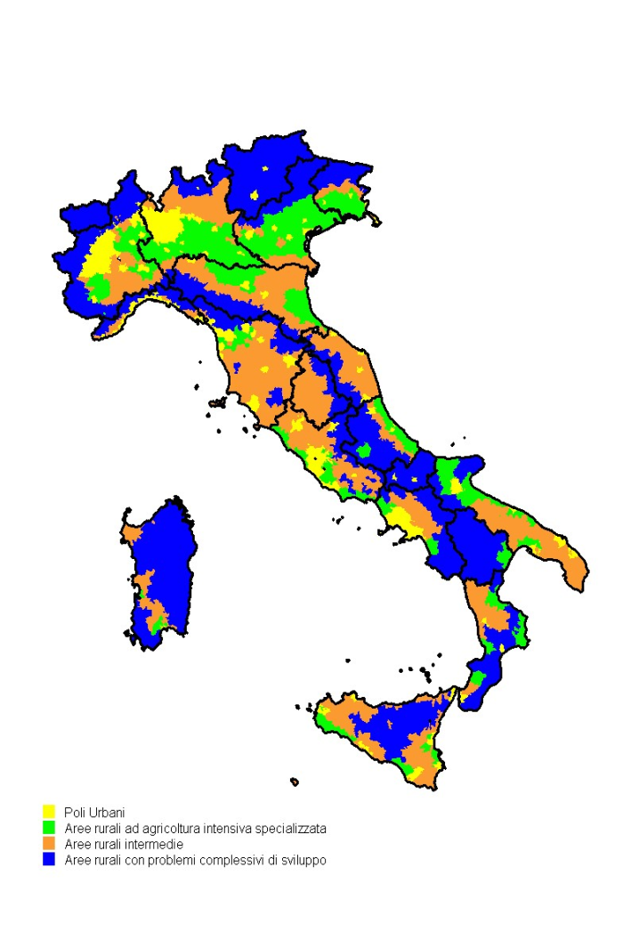
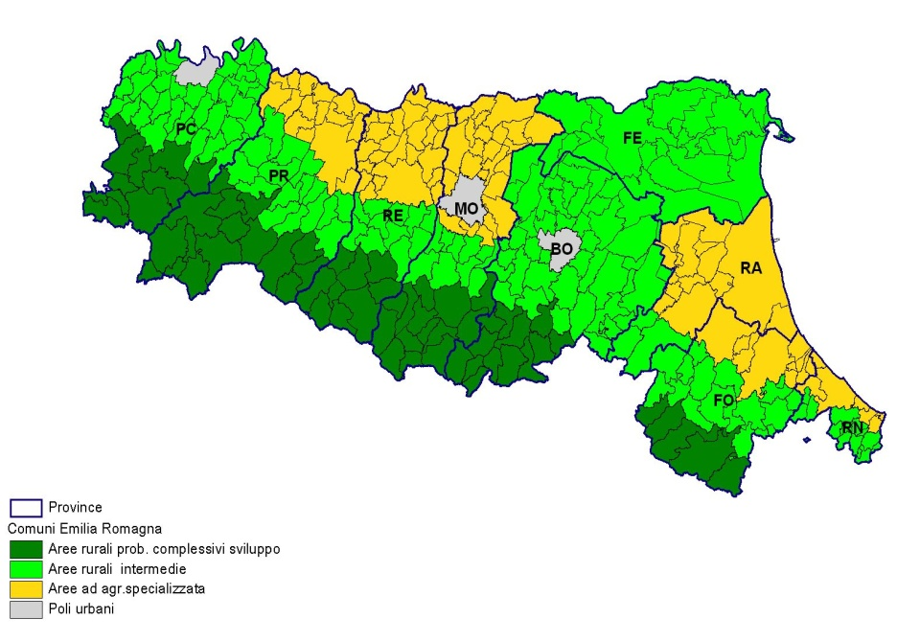
General overwiev of Emilia Romagna Region
Rural areas in Regional RDP
Roberto Gigante – I.N.E.A. – Emilia Romagna Region

Slide 14
Division of economic resources in Italy - EAFRD
Roberto Gigante – I.N.E.A. – Emilia Romagna Region

Slide 15
Caracteristics of our Region
Socio-economic context:
Total population = 4.1 million inhabitants.
Population density = 187.6 in hab./km2.
Per capita GDP (pps) = 139% of EU-25 average.
Rural areas:
The 3 typologies of rural area defined by the NSP are present.
84% of the population and 98% of the territory.
Population density = 161.3 inhab./km2.
Roberto Gigante – I.N.E.A. – Emilia Romagna Region

Slide 16
Importance of the agricultural, forestry and food sector:
Land
utilisation
The utilised agricultural area covers 60% of the territory and forests 28%.
Holding
dimens
The average surface of the agricultural holdings is
12.3 ha (IT: 6.7 ha; EU: 16 ha).
Value
added
The primary sector represents 3.2% of the regional value added and food industry 3.9%. In the 2008 the V.A of 1° primary sector (about 2.115 million ) represented 9,7% of the national
UAA - utilised agricultural area -1,074,552 ha
arable land (77.6%) , permanent crops (13.6%) permanent pastures (8.7%)
Employment
Employment in the primary sector respects 5.5% of the regional total.

Slide 17
Strategy
Favor organization and aggregations of chain
Favor the environmental rule of agriculture, sustainability of productions model and protect the biodiversity
Favor food safety, food quality and protect the distinction of products origin (13 DOP and 11 Gi)
Favor the production of renewable energy
Favor the multifunctionality of rural farms
Promote development of rural areas, and protection of environment
The needed to focus the interventions to the specific targets detected before and to definite areas requires a selectivity choice in order to have a better allocation of public resources.
Roberto Gigante – I.N.E.A. – Emilia Romagna Region

Slide 18
Objective for Axes
Three macro objective:
  1) Improving the competitiveness of agriculture and forestry through support to restructuring of the sector
  2) Improvement of the environment and rural development through support to the management of the territory
  Improvement of the quality of life in rural areas and promoting the diversification of economic activities.
Four priority axes :
  Axes 1 improvement of competitiveness of the agricultural and forestry sectors
  Axes 2 territory management
  Axes 3 diversification of the rural economy and quality of life
  Axes 4 leader approach
Roberto Gigante – I.N.E.A. – Emilia Romagna Region

Slide 19
Summary of different measures activated
Axes 1 – 9 measures on 14 scheduled
Axes 2 – 8 measures on 13 scheduled
Axes 3 – 7 measures on 8 scheduled
Axes 4 – LEADER : 5 measures on 5 scheduled
Technical assistance
29 measures proposed on 41 scheduled against of 14 activated in the last RDP program of 2000-2006.
+ 1 with Health Check reform = TOTAL OF 30
Roberto Gigante – I.N.E.A. – Emilia Romagna Region

Slide 20
Cross thematic priority
The Regional Rural Development Program will assume some thematic priority cross the axes and also cross the areas defined before:
  Aids and favor to young entrepreneur
  Improve the value of agricultural products made by biological process;
  Promotion of quality products - OGM free ;
  Improve and support and the development of chain for the production of renewable energy
Roberto Gigante – I.N.E.A. – Emilia Romagna Region

Slide 21
Territorial priority
Axes 1: differentiate the percentage of appropriation for holdings in less-favoured areas ( areas with overall issues of development and part of intermediate rural areas);
Axes 2: the application of special allowances for the less-favoured areas (all areas with overall issues of development and part of intermediate rural areas)
Axes 3: focus the interventions in intermediate areas with a greater degree of rurality (areas with overall development issues and intermediate rural areas)
Axes 4: territories selected for the Leader initiatives: areas with overall development issues and intermediate rural areas
Roberto Gigante – I.N.E.A. – Emilia Romagna Region

Slide 22




Governance scheme
RDP
Thematic priority for axes and measures enabled
Cross priority in coherence with cohesion policy and other
Definition of over-provincial interventions
Programming
step
Provincial RDP
Coherence with: regional low 2/2004, cohesion policy, integration of interventions of different axes
LAP
program
Thematic priority for axes at local level
Directive for the LAP (LAG programs)
Implementation
step
Provincial documents – by axes and by territorial authority (Provincial and Mountains Community)
Regional documents - realization for axes
Documents for LAP realization
Roberto Gigante – I.N.E.A. – Emilia Romagna Region

Slide 23
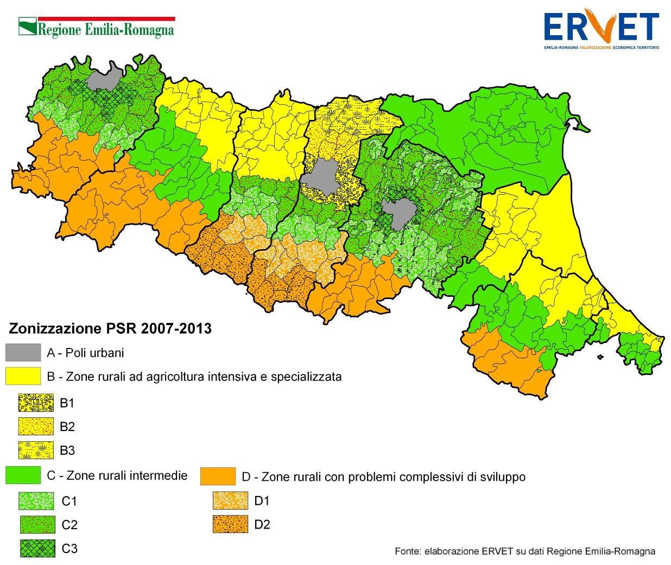
Rural areas: as detailed in the Province RDP

Slide 24
Governance
Introduction of management conjoint responsibility, through: the allocation of the large part of resources at the provincial level:
  definition of mechanism of “premium” compensation in the allocation of resources between territorial bodies in order to achieve the full use of financial resources allocated to rural development.
In overall terms, the allotment of resources provides:
the 71 % of the total resources of the RDP will be allocated (assigned) to the provinces for the financing of the PRIP;
the 24 % reserved to the region for interventions of over-provincial nature;
the 5 % allocated to the LAG.
Roberto Gigante – I.N.E.A. – Emilia Romagna Region

Slide 25
Financial table
Assi | Risorse totali attuali | % | Risorse totali post health check | %
Axes 1 | 168.500.000 | 41,0% | 206.861.258 | 42,8%
Axes 2 | 174.738.500 | 42,5% | 196.829.531 | 40,7%
Axes 3 | 42.900.000 | 10,43% | 52.540.342 | 10,9%
Axes 4 | 21.000.000 | 5,11% | 23.241.370 | 4,8%
TA | 4.112.500 | 1,00% | 4.112.500 | 0,9%
Total | 411.251.000 | 100% | 483.585.000 | 100%
Importi in spesa pubblica
Assi | Risorse totali attuali | % | Risorse totali post health check | %
Axes 1 | 382.954.545 | 41,0% | 447.272.097 | 42,3%
Axes 2 | 397.132.955 | 42,5% | 434.580.393 | 41,1%
Axes 3 | 97.500.000 | 10,4% | 113.611.801 | 10,8%
Axes 4 | 47.727.273 | 5,1% | 51.532.970 | 4,9%
TA | 9.346.591 | 1,0% | 9.346.591 | 0,9%
Total | 934.661.364 | 100% | 1.056.343.852 | 100,00%
Include + 72,3 M.euro
Include + 121,8 M.euro
Roberto Gigante – I.N.E.A. – Emilia Romagna Region

Slide 26
RDP – organizational model in the programming step:
Policy Maker
Thematich working groups
Group of coordination
Consulted subjects
Agroenviromental and forests
Provinces
Competivity of farms
Mountain Community
Local development
Agricultural consult
Monitoring and evaluation
Environmentalists consumers
Roberto Gigante – I.N.E.A. – Emilia Romagna Region

Slide 27

Management scheme
Monitoring commission
Regional antennas
Authority
Management
AGREA
(Autority for payment and control)
Monitoring and evaluation group
Management committee
LAG
PROVINCES
•
4 persons
Formed by measures and
transversal themes responsibles
•
coordination of evaluation activities
•
•
producing of monitoring informations
•
verifyng the quality of evaluation reports
Follows the management of RDP
•
Evaluation steering group
•
Formed by 16 regional experts
•
•
Supporting Monitoring and evaluation
group in verifyng the quality of
evaluation reports
Roberto Gigante – I.N.E.A. – Emilia Romagna Region

Slide 28
Finally, why building the Network?
To go over the isolation of rural development with other sectors, and favor a bottom up approach.
Realize a large-scale model be up to spill over knowledge on rural development, and highlight the positive effects on territory
To amplify effects and enhance the performance of join interventions
Roberto Gigante – I.N.E.A. – Emilia Romagna Region

Slide 29
Thank you for your attention
www.reterurale.it
www.ermesagricoltura.it
RGigante@Regione.Emilia-Romagna.it
TSchipani@Regione.Emilia-Romagna.it
Roberto Gigante – I.N.E.A. – Emilia Romagna Region

