Slide 17
Smart society and digitation in Time Elin Wetås de Jara Communications manager

Slide 18
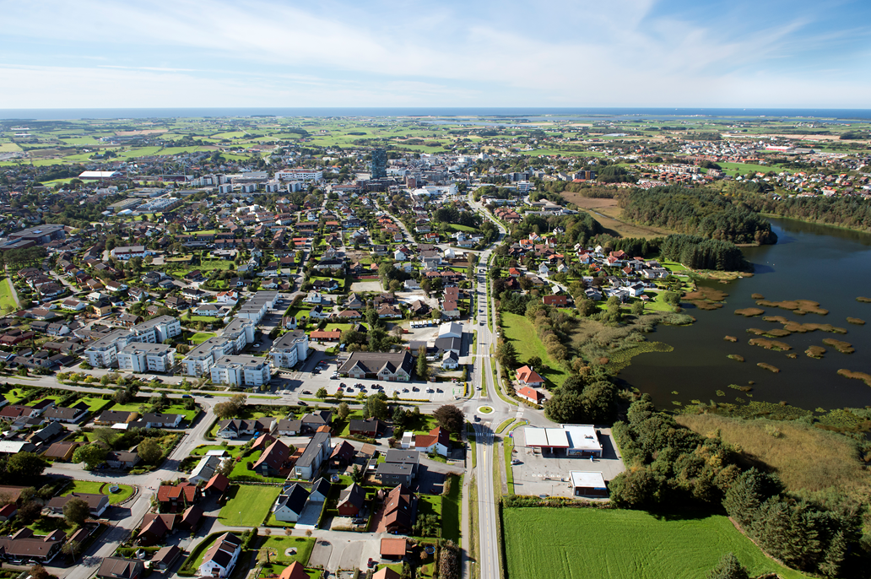
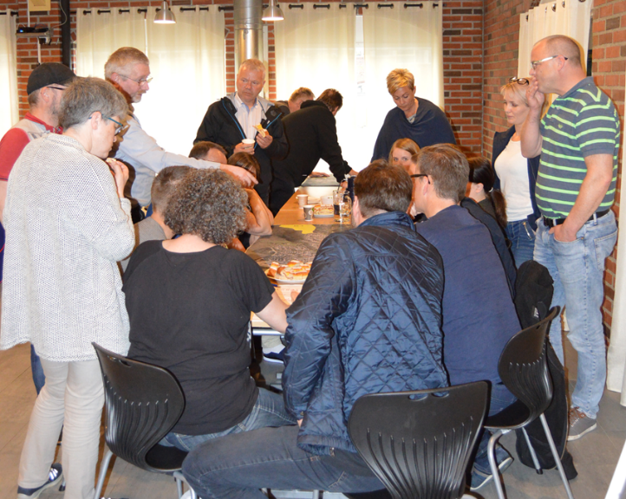
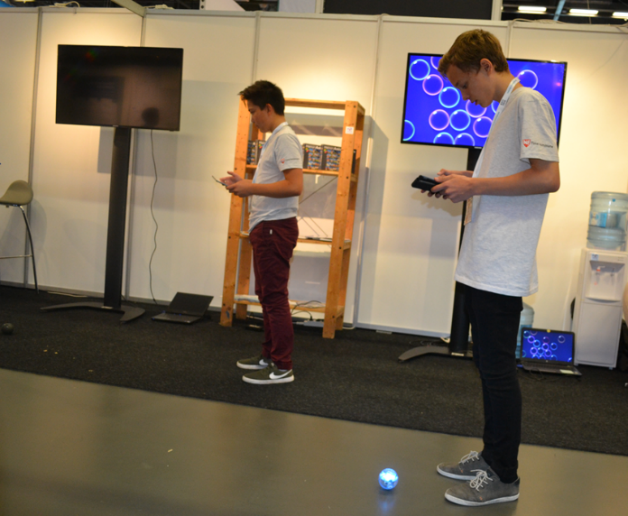
Smart Health Education Mobility Government

Slide 19
Example: «About Time» - a co-creation project

