Slide 1
Lower Silesia
main investment directions
automotive, white goods, BPO, IT, tourism and wellness
WHERE WE ARE AND WHAT IS NEXT?

Slide 2
LOCATION

Slide 3
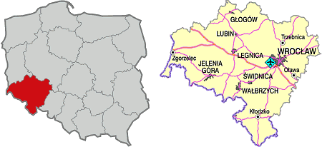
IN A NUTSHELL (March 2013)
Area: 19.947 sq km
Unemployment rate: 14.5 %
Population: 2.94 million (at working age: 1.88 million)
Wrocław: first Polish city incorporated into the European highway system
Number of institutions of higher education: 35, among which 11 State and 24 Non-state Universities
Number of students: 168.5 thousand (24 thousand graduates)

Slide 4
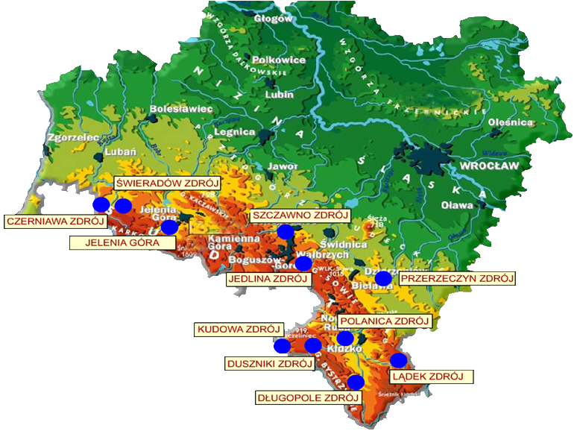
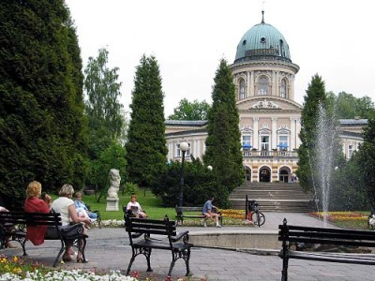
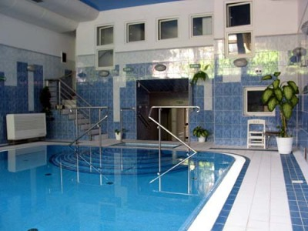
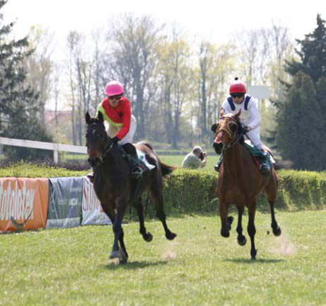
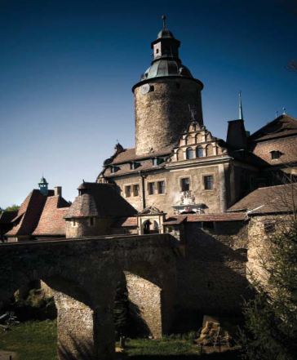
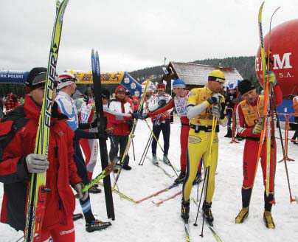
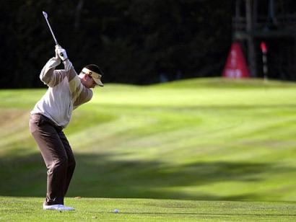
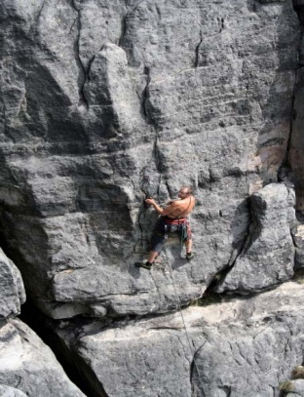
TOURISM WELLNESS

Slide 5
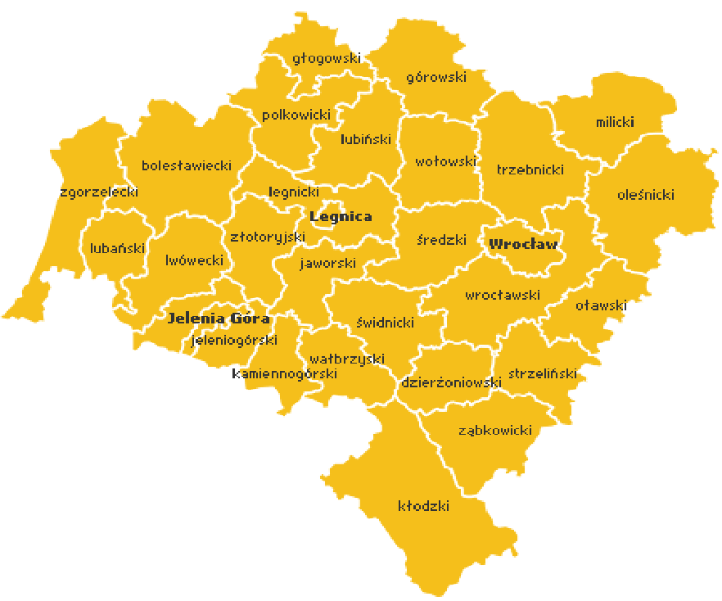
AUTOMOTIVE

Slide 6
ELECTROMECHANICAL
HOUSEHOLD

Slide 7
WROCŁAW CENTRE
OF IT/BPO

Slide 8
LOWER SILESIA DEVELOPMENT STRATEGY 2020
One of the main fields of intervention:
Highway of the New Economy
Perfect connections
Rising employment and labour mobility
Support to the enterprises’ competitiveness
Knowledge Based Economy

Slide 9
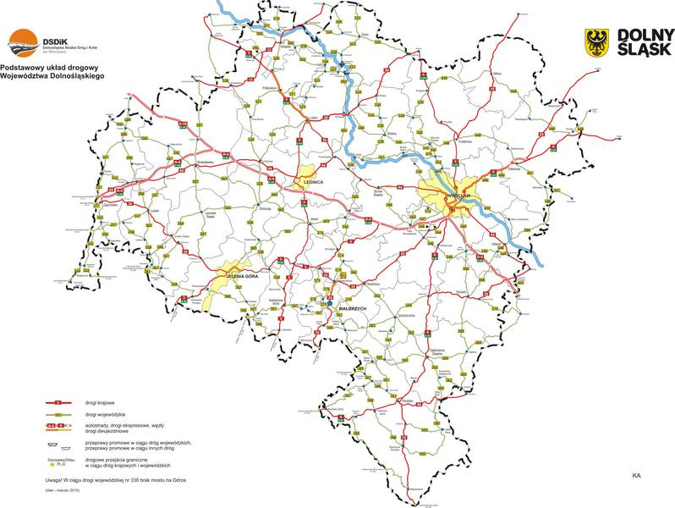
PROJECTS PIPELINE
- Technology Parks
-Business incubators
-Infrastructure investments
-Financial tools
-Vocational education
- Trainings
Highway
of the New Economy

Slide 10
Malgorzata Chalabala – Head Manager
Lower Silesia Agency
of Economic Cooperation
ul. Kotlarska 42, 50-151 Wrocław
Tel +48 71 344 02 86
Fax +48 71 344 02 85
biuro@dawg.pl
malgorzata.chalabala@dawg.pl
+48 71 343 4234
+48 608 660 700 mobile
Robert Śliwiński – Project Manager
robert.sliwinski@dawg.pl
+48 71 343 4234
+48 608 621 200 mobile
THANK YOU !

