Slide 1
A roadmap to energy efficient community-different approaches, the same aim
Thomas Duwe

Slide 2
5.2.1 Analysis of energy consumption data in communities
seven communities from four countries:
Duplek (Slovenia)
Prusice (Poland)
Blansko and Opava (Czech Republic)
Niestetal, Baunatal, Cölbe (Germany)
Value | Inh. | Inh./km² | GWh | t CO2 | GWh/inh. | t CO2/inh.
Min | 6,651 | 60 | 36 | 12,026 | 5,428 | 1.81
Max | 48,456 | 1,148 | 730 | 344,068 | 17,404 | 6.38
Median | 10,572 | 478 | 184 | 59,082 | 13,878 | 4.08

Slide 3
Duplek - 6,651 inh. - 166 inh./km²
Sector | end energy | CO₂ | End energy per person | CO₂ per person
heat | 21.5 GWh | 4,361 t/a | 3,233 kWh | 0.66 t/a/p
electricity | 13.5 GWh | 7,125 t/a | 2,030 kWh | 1.07 t/a/p
total | 36.1 GWh | 12,026 t/a | 5,428 kWh | 1.81 t/a/p
Sector | Potential | Potential | CO₂- savings | CO₂- savings
heat | 13 GWh | 60 % | 2,637 t/a | 60 %
electricity | 3 GWh | 22 % | 1,583 t/a | 22 %
total | 16 GWh | 46 % | 4.220 t/a | 37 %
Small, next to big city, low heating demand, little industry

Slide 4
Prusice - 9,377 inh. - 60 inh./km²
Sector | end energy | CO₂ | End energy per person | CO₂ per person
heat | 90.3 GWh | 17,400 t/a | 9,630 kWh | 1.86 t/a/p
electricity | 12.9 GWh | 15,300 t/a | 1,376 kWh | 1.63 t/a/p
total | 103 GWh | 32,700 t/a | 11,006 kWh | 3.49 t/a/p
Sector | Potential | Potential | CO₂- savings | CO₂- savings
heat | 59 GWh | 65 % | 11,292 t/a | 65 %
electricity | 2 GWh | 16 % | 2,372 t/a | 16 %
total | 61 GWh | 59 % | 13,664 t/a | 43 %
Rural area
No gas grid - Wood and oil for heating
Very low electricity demand
High heat demand per m²

Slide 5
Opava - 58,456 inh. - 650 inh./km²
Sector | end energy | CO₂ | End energy per person | CO₂ per person
heat | 473 GWh | 77,206 t/a | 8,092 kWh | 1.32 t/a/p
electricity | 257 GWh | 266,862 t/a | 4,396 kWh | 4.57 t/a/p
total | 730 GWh | 344,068 t/a | 12,488 kWh | 5.89 t/a/p
Sector | Potential | Potential | CO₂- savings | CO₂- savings
heat | 189 GWh | 40 % | 41,623 t/a | 40 %
electricity | 44 GWh | 17 % | 52,957 t/a | 17 %
total | 233 GWh | 32 % | 94,580 t/a | 22 %
Big industry
Gas and heating network

Slide 6
Blansko - 21,000 inh. - 1,148 inh./km²
Sector | end energy | CO₂ | End energy per person | CO₂ per person
heat | 268 GWh | 56,000 t/a | 12,762 kWh | 2.67 t/a/p
electricity | 68 GWh | 78,000 t/a | 3,238 kWh | 3.71 t/a/p
total | 336 GWh | 134,000 t/a | 16,000 kWh | 6.38 t/a/p
Sector | Potential | Potential | CO₂- savings | CO₂- savings
heat | 84 GWh | 31 % | 17,552 t/a | 31 %
electricity | 14 GWh | 21 % | 16,059 t/a | 21 %
total | 98 GWh | 29 % | 33,611 t/a | 25 %
Very dens city
Huge gas consumption in industry – lower % saving potential
Heating network and gas for heating!
Emission saving through RES!!

Slide 7
Niestetal - 10,572 inh. - 478 inh./km²
Sector | end energy | CO₂ | End energy per person | CO₂ per person
heat | 143 GWh | 39,347 t/a | 13,526 kWh | 3.72 t/a/p
electricity | 41 GWh | 19,735 t/a | 3,878 kWh | 1.87 t/a/p
total | 184 GWh | 59,082 t/a | 17,404 kWh | 5.59 t/a/p
Sector | Potential | Potential | CO₂- savings | CO₂- savings
heat | 103 GWh | 72 % | 28,341 t/a | 72 %
electricity | 8 GWh | 20 % | 3,851 t/a | 20 %
total | 111 GWh | 60 % | 32,192 t/a | 54 %
Small city next to Kassel
Highest per capita consumption – highest saving potential
Saving potential through less m² per person!!

Slide 8
Baunatal - 27,747 inh. - 728 inh./km²
Sector | end energy | CO₂ | End energy per person | CO₂ per person
heat | 268 GWh | 56,000 t/a | 12,762 kWh | 2.67 t/a/p
electricity | 68 GWh | 78,000 t/a | 3,238 kWh | 3.71 t/a/p
total | 336 GWh | 134,000 t/a | 16,000 kWh | 6.38 t/a/p
Sector | Potential | Potential | CO₂- savings | CO₂- savings
heat | 211 GWh | 67 % | 46,870 t/a | 67 %
electricity | 17 GWh | 19 % | 8,336 t/a | 19 %
total | 228 GWh | 57 % | 55.206 t/a | 49 %
City next to Kassel
VW production facility not included!
→ heating demand per person is higher in Germany!

Slide 9
Cölbe - 7,047 inh. - 264 inh./km²
Sector | end energy | CO₂ | End energy per person | CO₂ per person
heat | 72.6 GWh | 20,400 t/a | 10,302 kWh | 2.89 t/a/p
electricity | 25.2 GWh | 8,250 t/a | 3,576 kWh | 1.17 t/a/p
total | 97.8 GWh | 28,650 t/a | 13,878 kWh | 4.07 t/a/p
Sector | Potential | Potential | CO₂- savings | CO₂- savings
heat | 56 GWh | 68 % | 15,848 t/a | 68 %
electricity | 5 GWh | 20 % | 1,637 t/a | 20 %
total | 61 GWh | 63 % | 17.485 t/a | 54 %
more rural community
RES district heating in Schönstadt

Slide 10
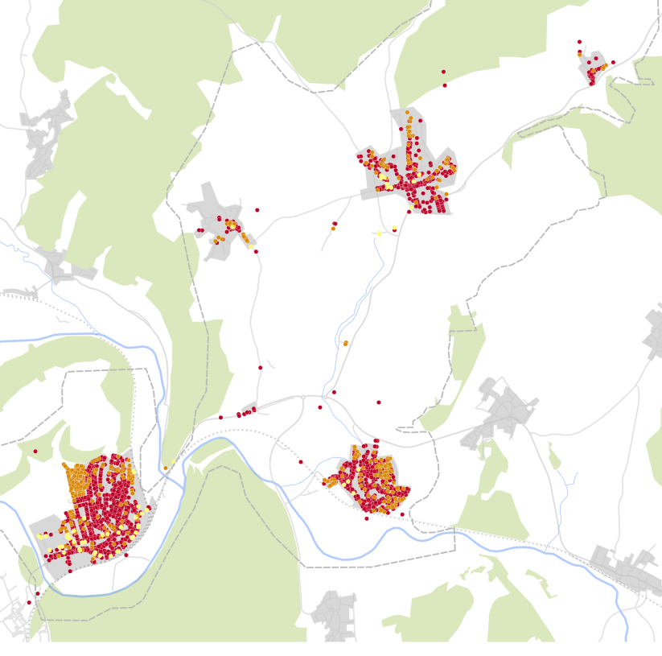
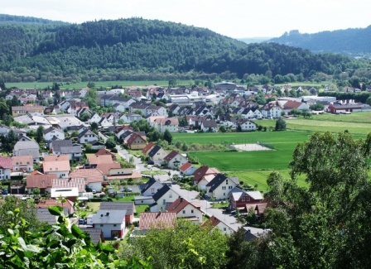
Different Approaches and Measures - Cölbe
Mobility main issue after heating
Next to Marburg, shuttle traffic, distance 12 km
Also: railway station: 6km
Ideal for E-bikes!
Need for bike boxes against theft and whether
App for reserving and checking availability
Can build on carsharing community and service
www.coelbe.de

Slide 11
Niestetal
Aim for CO2 neutrality in 2035
Need for building renovation: 3% or more
Acutally achieved through funding programm (ended)
Two quarter concepts. Goal: 5-6% by
Quarter manager will actively consulate citizens/house owners
Offer: contract with renovation roadmap with 5-6% grant
www.niestetal.de

Slide 12
Baunatal
www.baunatal.de
Quarter concepts
Extension district heating
Demografic affairs
Street renovation
E-mobility
Change of housing association – chance for new impuls
Barrier free
Tailoring of the apartments
LED in street lighting, 10-20% per year

Slide 13
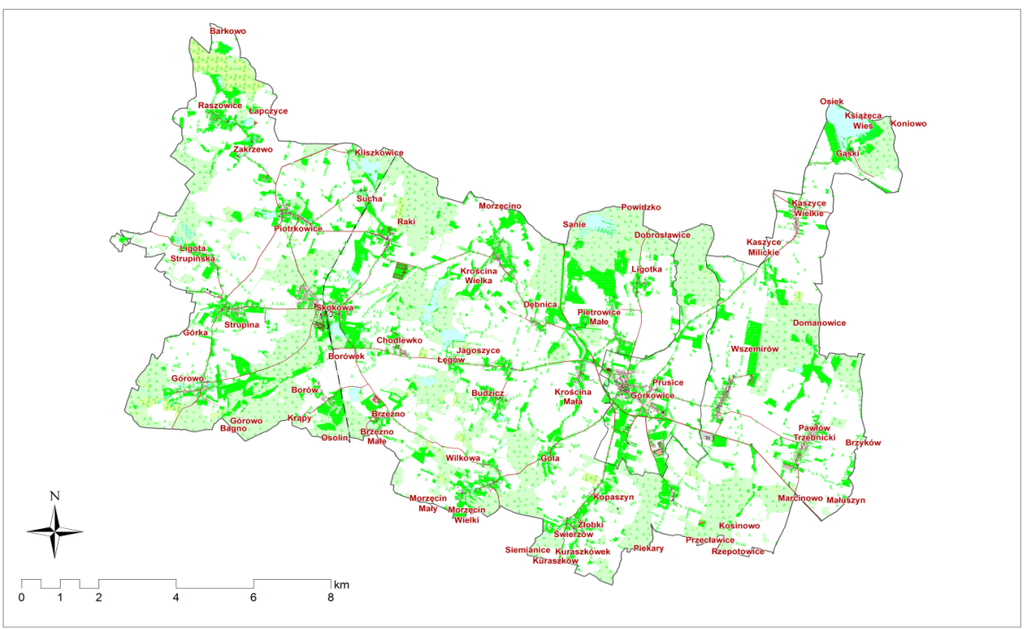
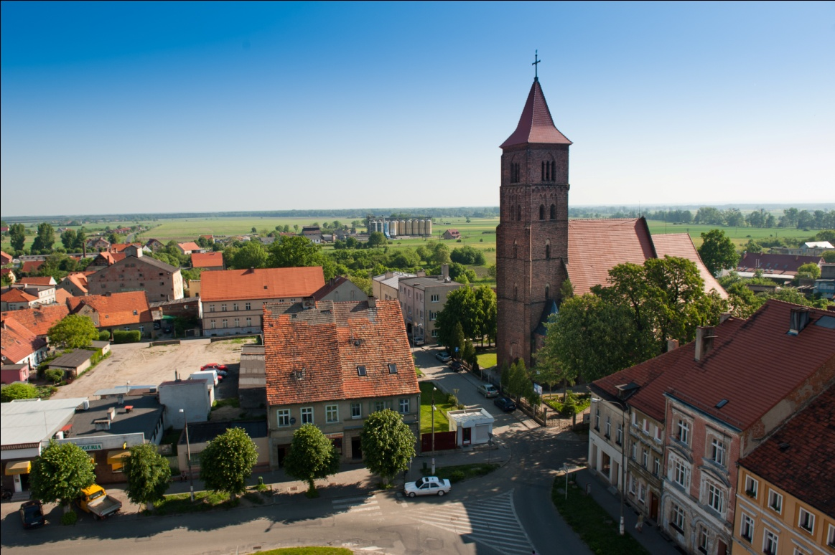
Prusice
Recommended actions:
Energetic renovationof buildings
Change of behaviour
exchange of devices
Exchange of old heating systems with more efficent ones
Subsidies for RES plants
www.prusice.pl

Slide 14
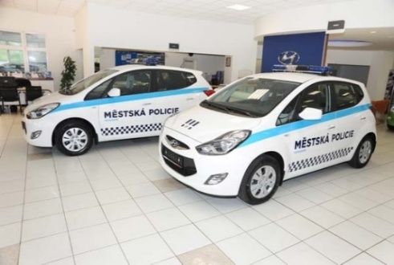
Statutory City of Opava
Advanced Strategic Energy Planning & Energy management
EPC and ESKO projects
Energy project buffer
Smart Meetering
E-mobility
Public transport fully electrical
City Police

Slide 15
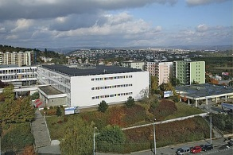
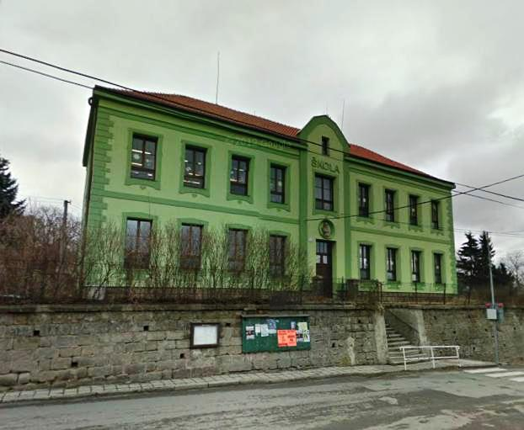
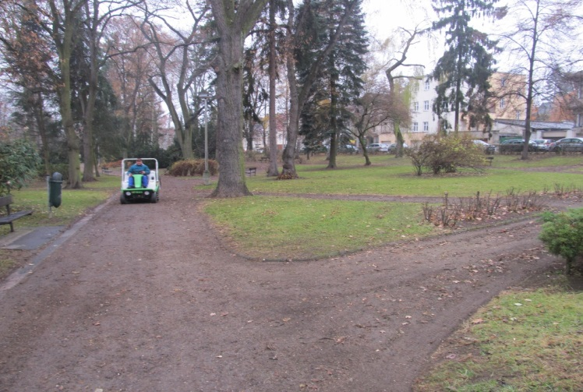
Statutory City of Opava
Projects Examples
PV system on primary schools and public buildings
Pilot project „Šrámkova primary school“
Biomass production
Cultivation of fast-growing trees on City grounds
Use of biomass from city parks and green areas
Complex building renovations
Mainly Primary schools

Slide 16
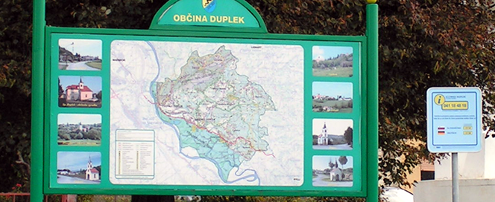
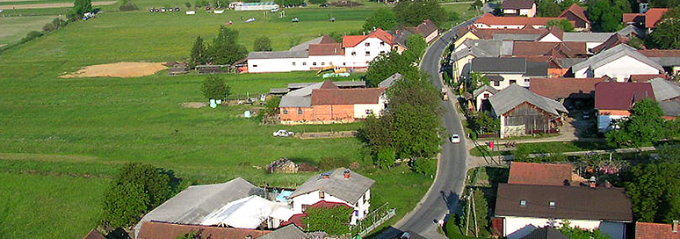
Duplek
Sector households:
Largest Energy efficiency/savings potential
Good potential for energy efficiency cooperatives, local/ national incentives;
Sector industry: undeveloped – largest potentials in electricity;
Public sector: highest potential in public lighting and thermo-modernization;
Traffic: next to biggest city of the region – Maribor; advocating use of sustainable mobility solutions (e-mobility, mobility on demand, alternative transport modes);
www.duplek.si

Slide 17
Thank you very much for attention!

