Slide 1
An Overview of ENERGYREGION feasibility study results
ENERGYREGION. This project is implemented through the CENTRAL EUROPE Programme co-financed by the ERDF.
PORSENNA o.p.s.
Wroclaw, November 25th, 2014
Notes:
1

Slide 2
Catalogue of Best Practice Examples
Catalogue of Measures
Small Hydro Power Plant
Wind Farm
Photovoltaic System
Biogas Plant
Other Methods of Generating Energy from Biomass
Heating Plants
Solar Thermal Systems
Heat Pump
Energy Efficiency Measures for Heating (low-cost)
Energy Efficiency Measures for Heating (high-cost)
Modernization of Street Lighting
Fuel Savings
Energy Efficiency Measures Leading to Electricity Savings
Thermal Insulation
Replacement of Windows and Doors
Installation Shading Elements on the Facade
Regulation of Heating System
Replacement of Radiators
Automatic Lighting Control System
Intelligent Control of Technical Building System
Solar thermal and photovoltaic systém
Distric Heating
Cogeneration Unit (CHP)
Heat Pump
Biomass Boiler
Stand-by Mode
Energy Management at the Level of Building and City

Slide 3
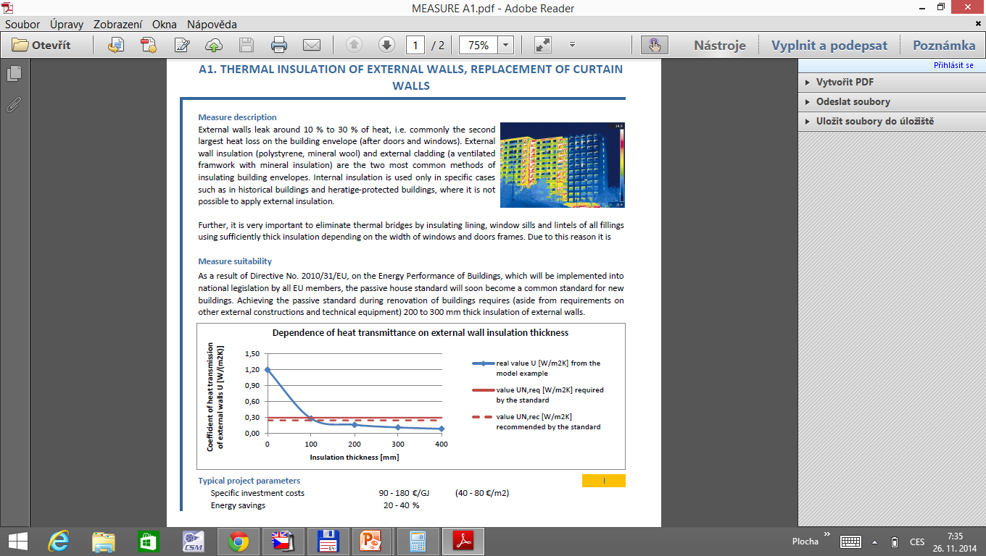
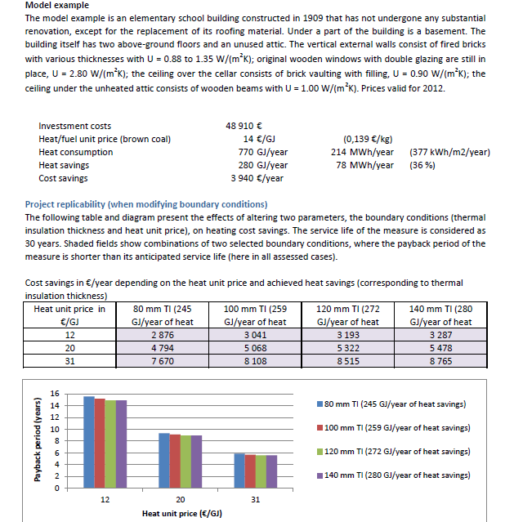

Slide 4
Regional meetings/questionnaire surveys
The objective - to identify the region stakeholder’s point of view on innovation and possible pilot activities.
Together 193 Questionnaires were collected, 24 meetings were organized.
Region | No. of Questionnaires | No. of Meetings
Statutory City of Opava | 19 | 6
South Moravian Region | 39 | 5
North Hesse Region | 69 | -
Prucise Region | 53 | -
Podravje Region | 13 | 13

Slide 5
Pilot Activities - Prusice Region
Project Title | Location | Short description
Cultivation of energy crops | Skokowa, Krościna Wielka, Pawlów Trzebnicki, Wszemirów | The estimated potential of renewable energy will reach 92,447.14 GJ of perennial crops in the area of 690.3 ha and 30,890.13 GJ of one-year plants growing in the area of 667.2 ha
Construction of biogas plants | Skokowa, Prusice | Construction of biogas plant, using waste from crop and animal.
Installation of biomass boilers for wood | Prusice Municipality | Changing the heating system – modern biomass boilers for wood from energy crops.
Installation of flat plate solar collectors in residential buildings | Prusice Municipality | Installing flat solar collectors on the floors of some buildings.
Installation of photovoltaic panels on the roof of a wastewater treatment plant | Piotrkowice Małe | Installation of 46 PV panels on the floor of social building in wastewater treatment plant
Installation of photovoltaic panels on the roof of a wastewater treatment plant | Piotrkowice Małe | Installation of 24 PV panels on the roof of sediment dewatering station
Small wind turbine installation | Piotrkowice | Small wind turbine based on wind measurements made in region.
Thermo-modernization of 3 public utility building | Prusice | Modernization of the Healthcare Center, Department of Public Utilities, Municipal Centre of Culture and Sport
Afforestation and trees plant program | Prusice municipality | Increasing the amount of wood and wood biomass throught a program of small retention and trees plant and afforestation of marginal land
Installation of time drivers | Prusice municipality | Installing time drivers in public buildings and private households

Slide 6
Pilot Activities – South Moravian Region
Project Title | Location | Short description
PV system for sewage treatment plant support | Buková Municipality | Project of PV power plant which will be able to cover part of local sewage treatment electricity consumption.
Heat source replacement | Podomí Municipality | Project of optimization of heat source replacement in public school building in Podomí municipality.
Heat insulation | Protivanov Municipality | Project of heat insulation of local school and kindergarten.
Wind power | Žernovník municipality | Project of realization of wind power plant on property held by Žernovník municipality.
Municipality building renovation | Habrůvka Municipality | Project of renovation of multifunctional municipality building (local authority, library) – heat insulation and heat source replacement.
Heat source replacement | Rudice Municipality | Project of heat source replacement in historical school building.
Heat insulation | Ostrov u Macochy Municipality | Project of heat insulation in case of local authority, community centre and historical school building.
Heating system modernization | Ostrov u Macochy Municipality | Project of heating system modernization in case of public school building.
Energy savings project | Drahany Municipality | Project of energy savings related to buildings of public school and local museum.
Advanced street lighting management | Podomí, Řícmanice, Vavřinec, Lubě, Ruprechtov, Studnice, Krásensko Municipality | Project of advanced online street lightning management.

Slide 7
Pilot Activities – City of Opava
Project Title | Location | Short description
PV system on primary school | Statutory City of Opava | Project of PV power plant which will be able to cover part of primary school Šrámkova electricity consumption.
Heat source replacement | Statutory City of Opava | Project of optimization of heat source replacement in public school building in Opava.
Heat insulation | Statutory City of Opava | Project of heat insulation of local school.
Complex building renovation | Statutory City of Opava | Complex building renovation of primary school Šrámkova.
Municipality building renovation | Statutory City of Opava | Project of renovation of City hall – heat insulation and heat source replacement.
Heat source replacement | Statutory City of Opava | Project of heat source replacement in historical school building. MALÉ HOŠTICE.
Lighting optimization | Statutory City of Opava | Lighting optimization in primary school Šrámkova.
Biomass production | Statutory City of Opava | Production of Biomass in Statutory city of Opava.

Slide 8
Pilot Activities – North Hesse Region
Project Title | Short description
Elaborating a strategy for a half-timber houses in urban cores or districts | Financing; Caretaker
Collaboration models | Custumer conectivity with producer
Self organizing villages | Cooperative for energy but also for food and mobility
Central composting plant | Exchange waste for compost
Metering and adjusting consumption | Equip a village, a small region with devices that enable to use power if there is a lot (high voltage and frequency in the grid).
Energy concept for a quarter with fitted funding programme | Elaboration of a quarter concept and then adjust the general funding programmes for the recommended solutions to the specific circumstances.
Craftsmen buy, renew and resell houses | This way quality and regional added value is guaranteed .
Local energy market, direct marketing | Establish a test market on local level
Contracting renovation | Set up a business model for small buildings
Replacing Half-timber houses in urban cores | Elaboration of a strategy, how to deal with owner Refurbishment conflict.

Slide 9
Pilot Activities – Podravje Region
Project Title | Location | Short description
Kinder Garden | Kidričevo | Energy consumption: 182 MWh (2008/09); Heating: DHS (waste heat)
Primary School | Kidričevo | Project for energy savings – 25 %
Primary school | Lovrenc | Project for energy savings – 30 %
Primary School | Zgornja Korena | Savings: app. 63 MWh; Heating: LHO-in y. 2015 replacement of heating system
Municipality Duplek | Duplek | Project for energy savings – 54 %
Primary School | Starše | Energy consumption (before): 326 / Ref. 272 MWh ; Energy cons. (after): 159.2 MWh Heating system: biomass boiler
Kinder Garden | Starše | Energy consumption (after): 8,6 MWh (app. 70 %)
Multipurpose Cultural Hall | Vitomarci | Energy consumption: MWh; Heating needs (est. 3M): 14.5 MWh; Heating system: Heat pump (air-water)
Primary School | Cirkulane | Project for energy savings – 60 %
School Gym | Cirkulane | Project for energy savings – 60 %

Slide 10
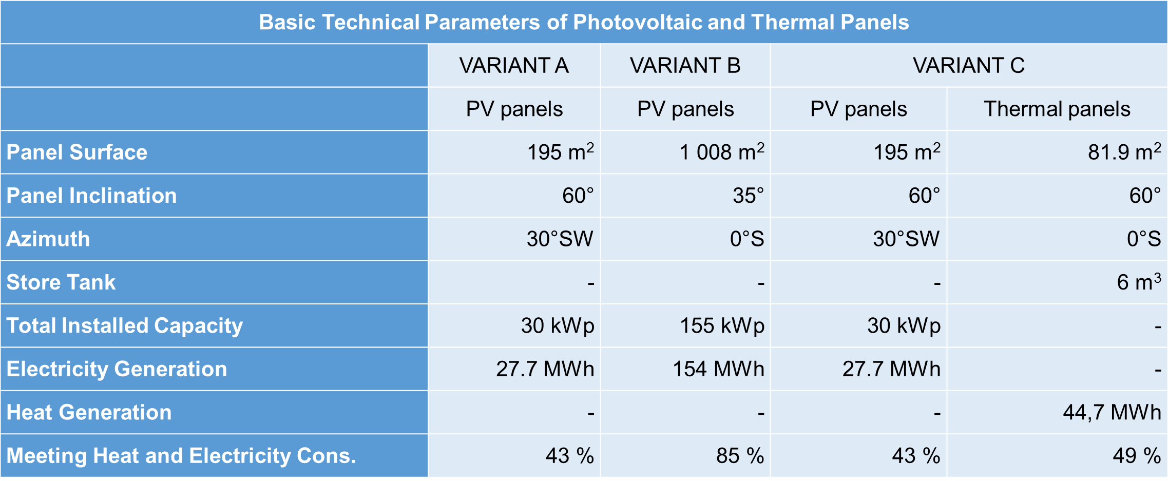
Photovoltaic Panels on Primary School Šrámkova

Slide 11
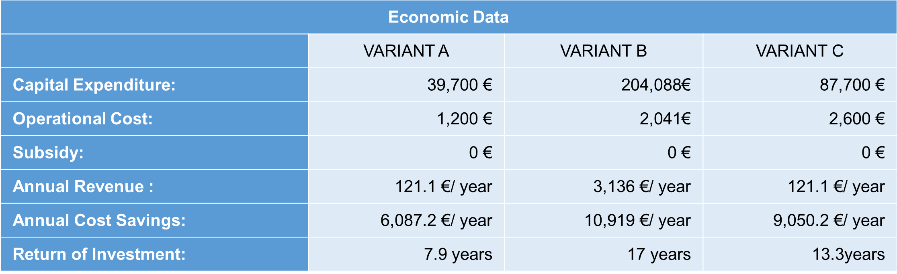
Photovoltaic Panels on Primary School Šrámkova

Slide 12
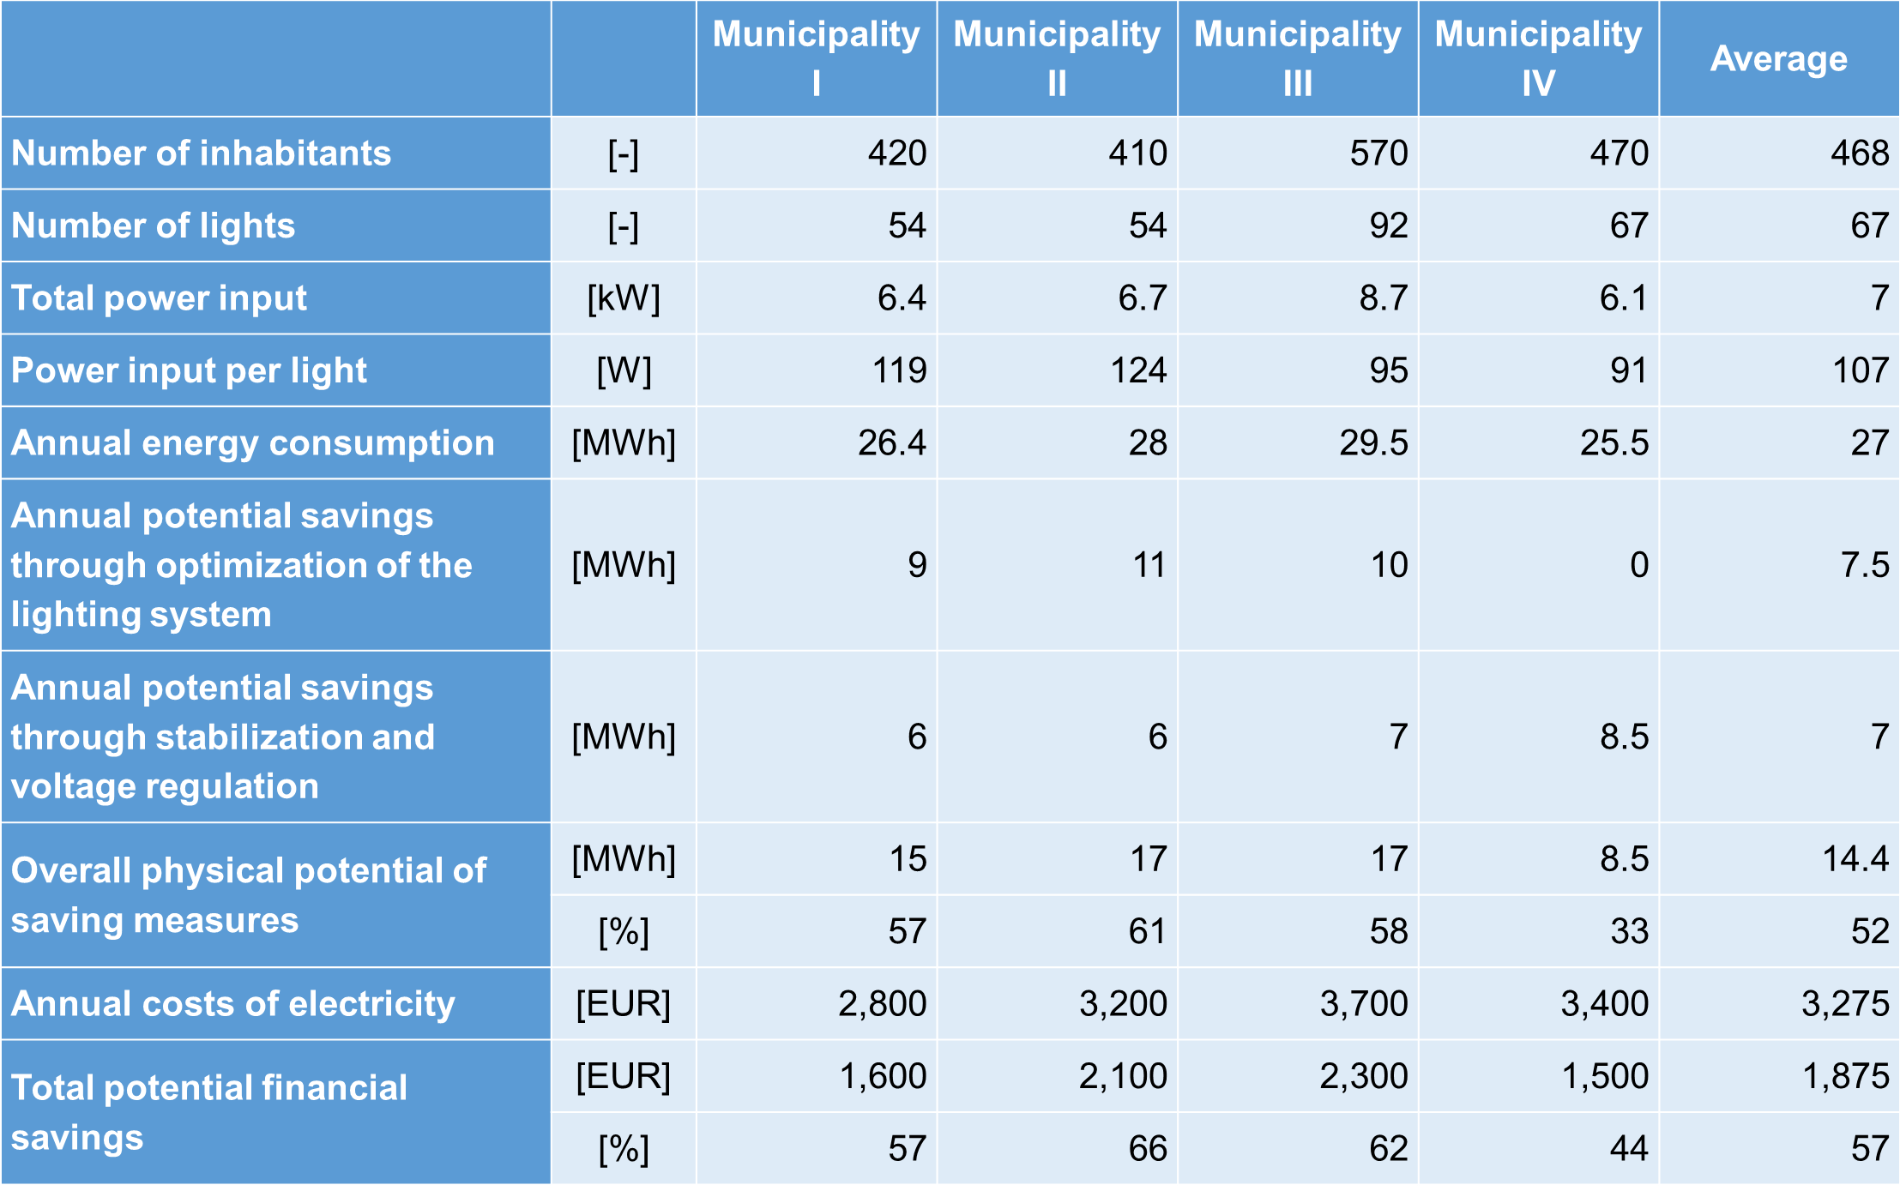
Local Action Group Moravian Karst – Public Lighting

Slide 13
Gertrudenstift care retirement home
Variant A „KfW 55”
Variant B „Passive House Standard”
Insulation Outer Walls | 20 cm (0,035 W(m*K))
Insulation Roof | 30 cm (0,035 W(m*K))
Insulation Basement | 12 cm (0,035 W(m*K))
Windows | 0,8 W/(m²*K)
Doors | 1,3 W/(m²*K)
Active Ventilation | Heat recovery rate of 80 %
Air tightness | Air change rat below 1,0/h
Insulation Outer Walls | 25 cm (0,035 W/(m*K))
Insulation Roof | 34 cm (0,035 W/(m*K))
Insulation Basement | 20 cm (0,035 W/(m*K))
Windows | 0,8 W/(m²*K)
Doors | 0,8 W/(m²*K)
Active Ventilation | Heat recovery rate over 80 %
Air tightness | Air change rat below 0,6/h
Capital expenditure: |  | 12.477,118 | €
Capital expenditure compared to the reference standard |  | 1.824,413 | €
Annual Revenue and costs savings: |  | 78,032 | €/year
Capital expenditure: |  | 12.895,519 | €
Capital expenditure compared to the reference standard |  | 2.242,814 | €
Annual Revenue and costs savings: |  | 84,620 | €/year

Slide 14
Wind turbine at municipal property - Prusice
Type of Turbine | Energy generates |  |  | Maximal Capacity Utilization Ratio 48 m | Maximal Capacity Utilization Ratio 38 m | Maximal Capacity Utilization Ratio 28 m
 | 48 m, Netto | 38 m, Netto | 28 m, Netto
ZEFIR D21-P70-T18 - 70 kW | 85,841 kWh | 69,349 kWh | - | 17.28 % | 13.96 % | -
 | 85.84 MWh | 69.35 MWh | -
ZEFIR D14-P30-T15- 30 kW | 36,476 kWh | 29,467 kWh | 25,339 kWh | 17.14 % | 13.84 % | 11.90 %
 | 36.48 MWh | 29.47 MWh | 25.34 MWh
ZEFIR D10-P12-T12- 12 kW | 17,700 kWh | 14,332 kWh | 12,494 kWh | 20.79 % | 16.83 % | 14.67 %
 | 17.70 MWh | 14.33 MWh | 12.49 MWh
ZEFIR D7-P5-T10- 5 kW | 8,037 kWh | 6,516 kWh | 5,714 kWh | 22.65 % | 18.37 % | 16.11 %
 | 8.04 MWh | 6.52 MWh | 5,71 MWh

Slide 15
Elementary School Lovrenc
Investment measures | Investment (EUR) | Energy savings (kWh/a) | Energy savings (EUR)
The façade (thermal insulation) | 28,966 | 3,407 | 596
Thermal insulation ceiling to unheated attic | 9,345 | 11,327 | 1,982
Replacement of joinery | 31,894 | 16,408 | 2,871
Replacement of therm. valves wt. hydraulic balancing | 1,682 | 1,283 | 224
Installation of heat pump for heating and hot water | 13,400 | 13,132 | 2,298
Total | 85,287 | 45,557 | 7,971

Slide 16
Thanks for attention
PORSENNA o.p.s.
Notes:
16
16

