Slide 1
Implementation of „energy change agents“ in German municipalities

Slide 2
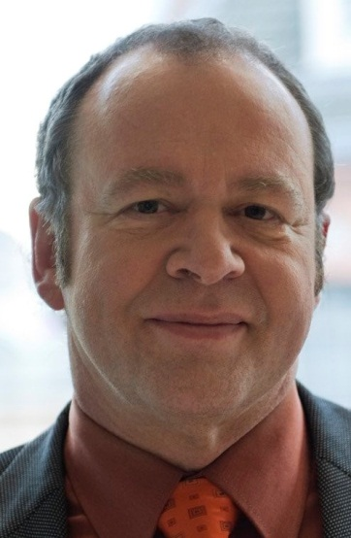
Arno Scheer Change agent, COMMUNITY OF Niestetal

Slide 3
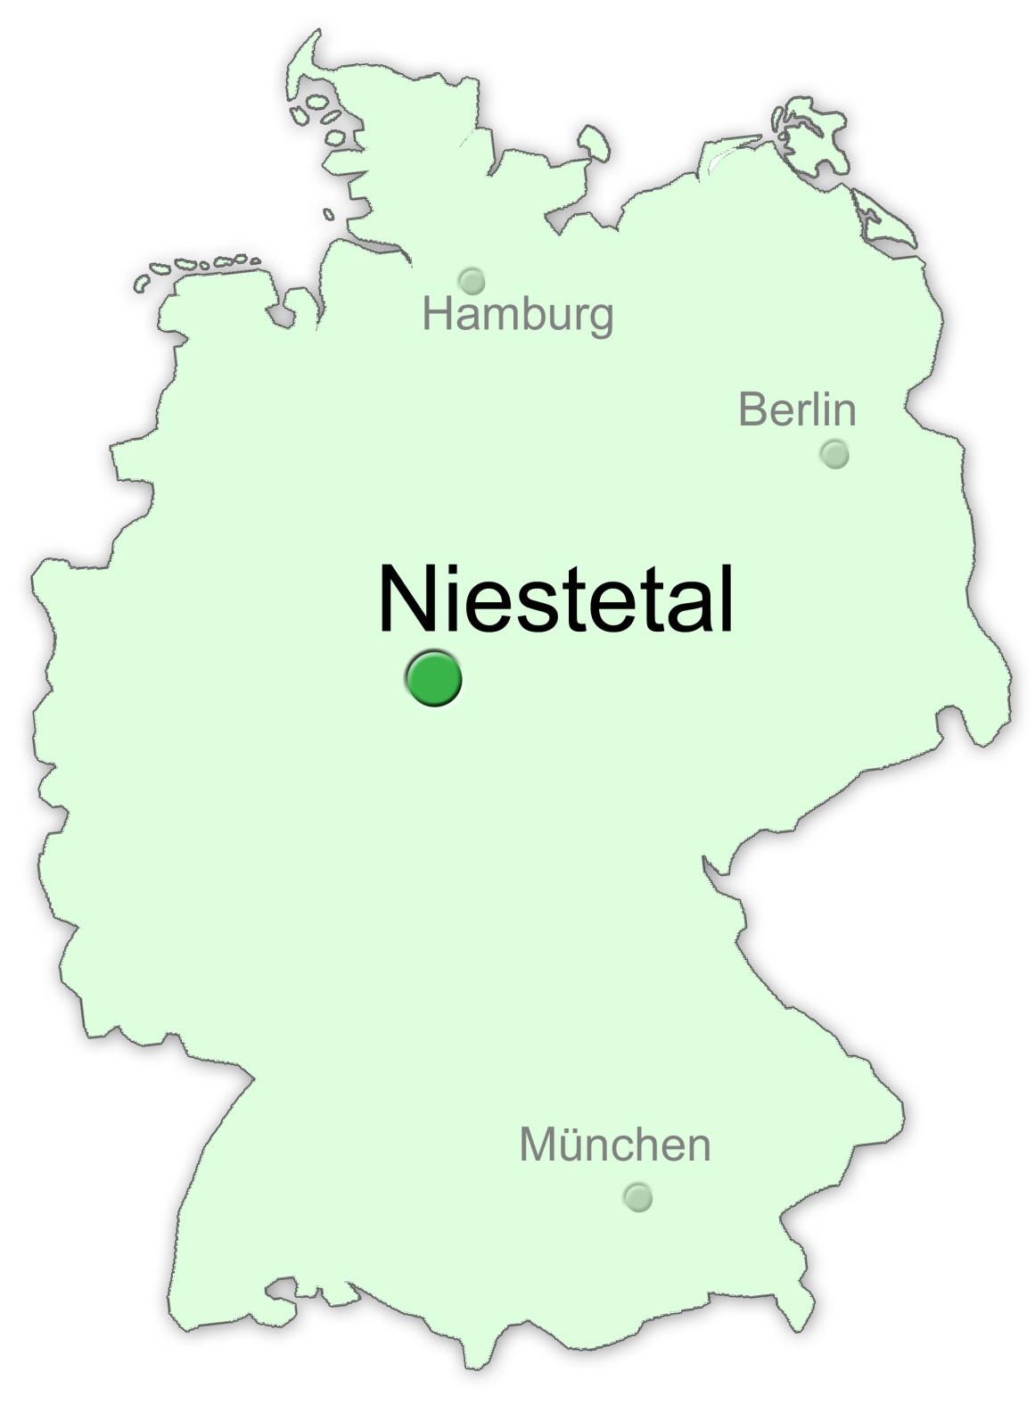
Community of Niestetal
About 10.600 inhabitants
Area: 2,215 acres
2 districts

Slide 4
Results of the Climate Protection Concept 2009 Annual energy demand in the community of Niestetal: 412 Gigawatt/h
Notes:
Die Sektoren Ernährung und Konsum sind wenig beeinflussbar, Mobilität wurde bislang ausgeklammert.

Slide 5
Derived destinations from the Climate Action Plan
Sustainable contribution to climate protection
Possible influence on energy prices
Independence from fossil fuels and nuclear power
Overall objective: CO2-neutral until 2035

Slide 6
National Climate Initiative
Source:

Slide 7
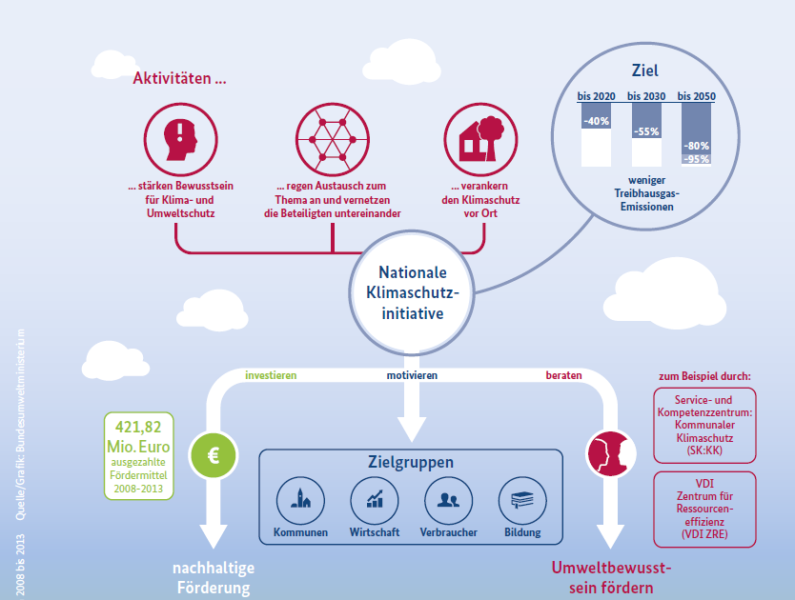
activities …
the aim
strenghten awareness
… anchoring of climate change locally
less green- house gases
… networking
National Climate Initiative
investing
motivating
consulting
disbursed support
target groups
communities
economy
consumer
education
promotion of sustainable funding
promote environ- mental awareness

Slide 8
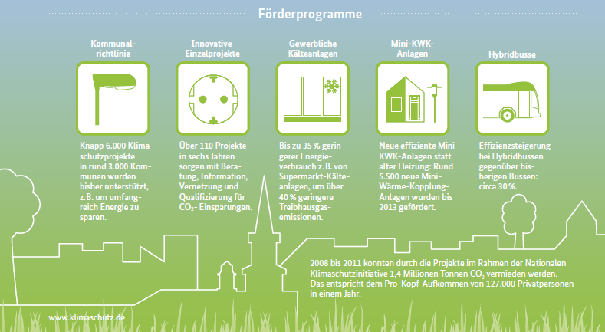
Funding programms from the german government
Funding programms
municipal council directive
Innovative indivi- dual projects
commercial refrigeration
mini-CHP-plants
hybrid busses

Slide 9
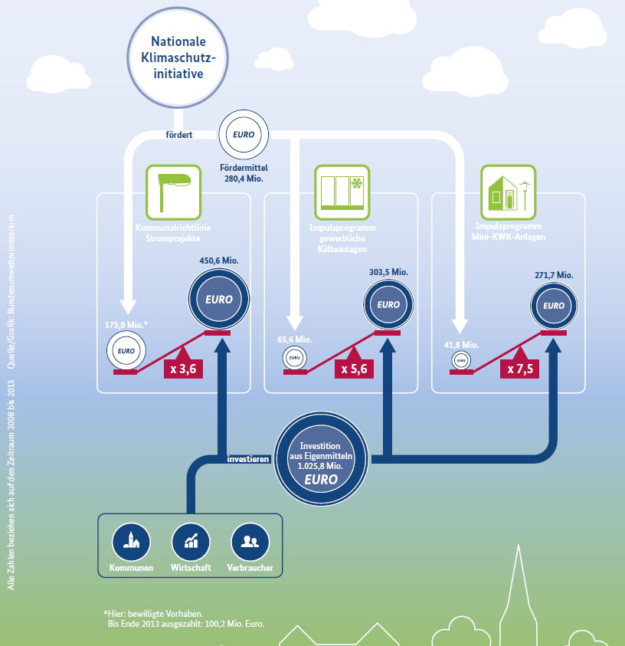
leverage effect
promotes
investing level
funding level
invested
Notes:
The experiences from the years 2008-2013 shows:
The fundings sets a process in motion by an leverage effect; so that the real investion is an level higher than the fundings, the factor is about 3.5 to 7.5 times higher

Slide 10
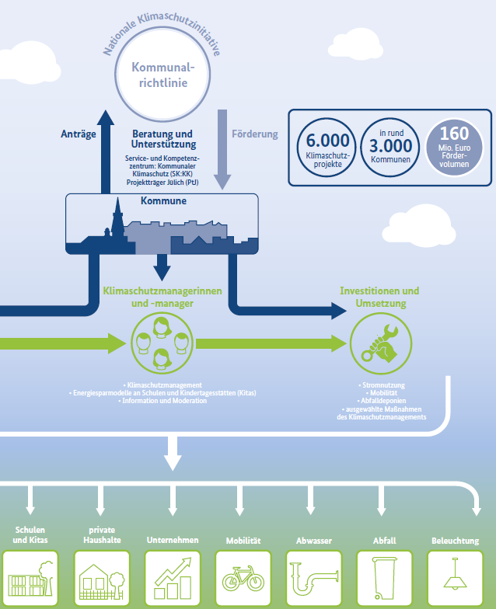
national climate initiative
municipal council directive
applications
consulting support
funding
municipalities
energy change agents
investment and implementation

Slide 11
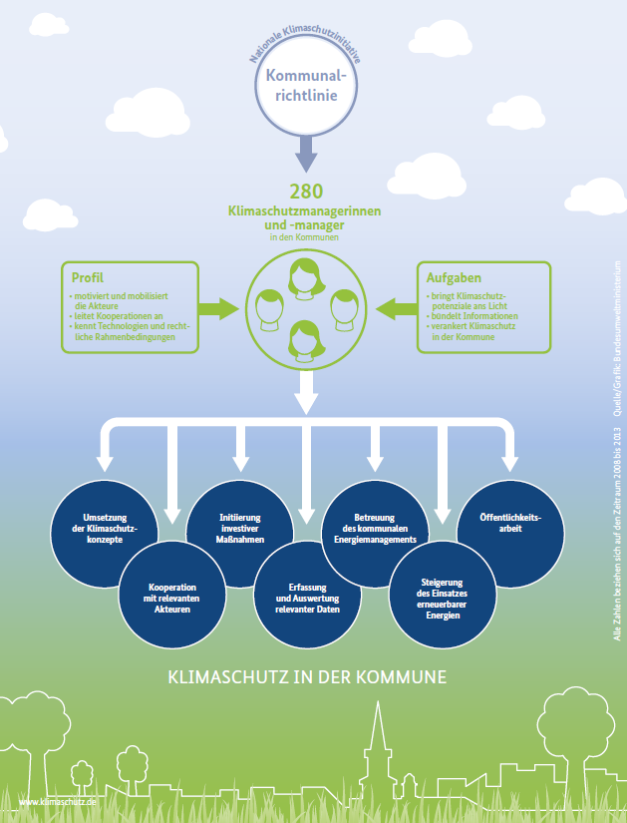
national climate initiative
Municipal council directive
energy change agents
task fields:
implementation
of the climate
protection concepts
initiation investing
measures
care of the
municipal energy
management
public relation
cooperation with
relevant actors
acquisition and
evaluation of
relevant data
increasing the use of renewable energies
Notes:
Well, the task fields are very wide: they had to do marketing, write speeches , be a Public Speaker or moderator, be an budget expert, psychologist, everyday companion for the elderly and so on. A collegue of mine said it in a speech, it will be about 20 professions, we had to do, every day.

Slide 12
Actions taken: some examples from Niestetal
Setting an change agent in December 2011
First time samples datas of public properties to get an overview in order to receive a plan
Insertion of a support program for climate protection: Building renovation and new construction as well as solar thermal
Supporting installation of RES
Establishment of a civil-energy cooperative
Repurchase of the electricity and gas grid
Inserting a district manager for energy-efficient urban redevelopment in the next year

Slide 13
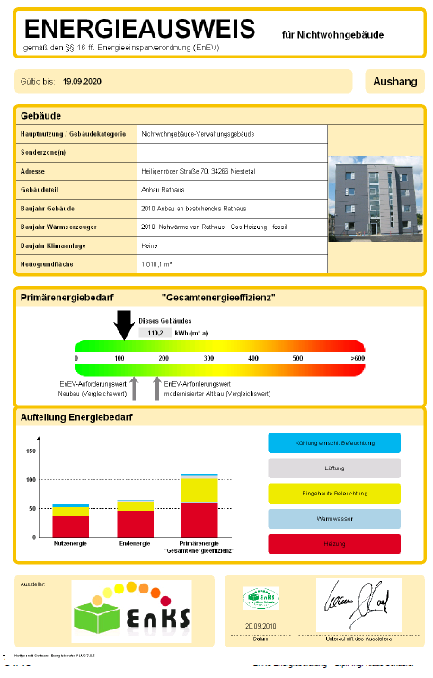
Public properties
working at the energy efficiency of public buildings: e.g. renovated major hall
Public procurement: e.g. vehicles for the administration e.g. green IT e.g. office supplies

Slide 14
Insertion of a support program for climate protection
Criterias:
Energy efficiency
Use of renewable energy sources
Sustainable building materials
Technical conditions

Slide 15
Results of the funding program
year | budget (€) | accessed (€)
2012 (10 months) | 215,000 | 83,000
2013 | 190,000 | 150,000
2014 (11 months) | 170,000 | 156,000

Slide 16
Insertion of a support program for climate protection results after 2,75 years
Partial renovations in > 8% of the buildings (3%/year) = 234 buildings
Funding of 32 new efficient houses
approximately 360,000 euros in grants use of the community
Costs app. 460 € / t CO₂ saving (for 20 years = 23 € / t CO₂ saving per year)
regional value about 2 times by getting several taxes for 1-3 years
approximately 4.1 million Euros investment of the residents (ratio 1:11)

Slide 17
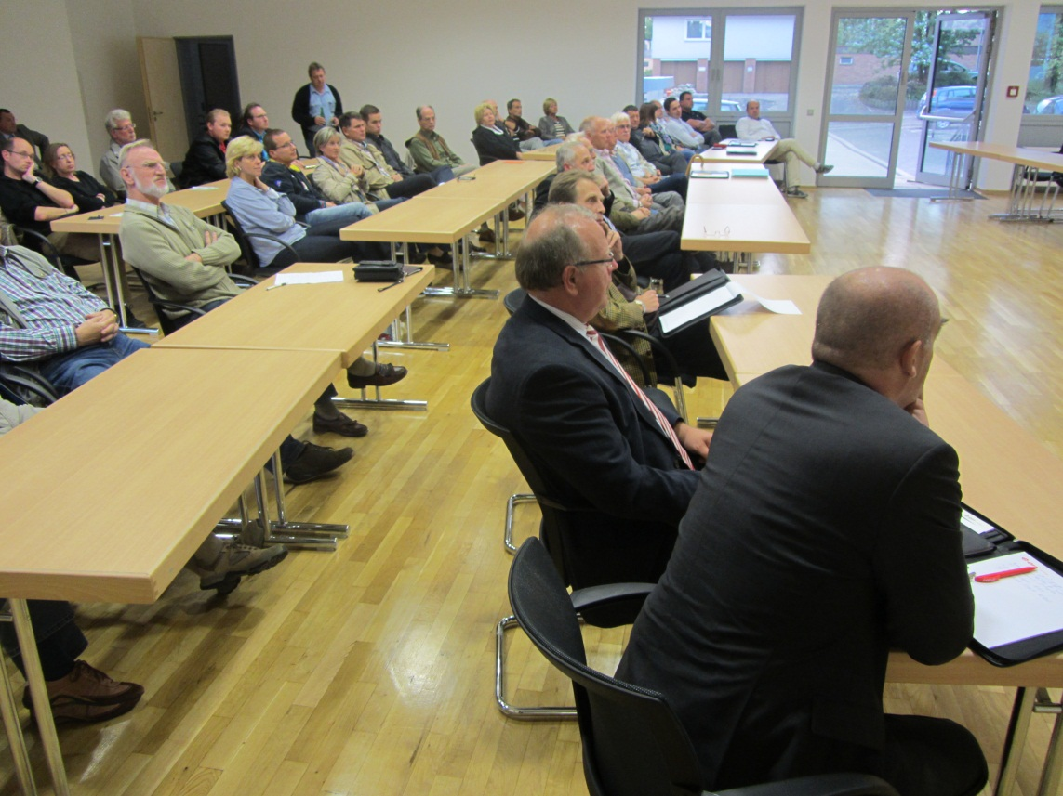
Establishment of a civil-energy cooperative
Coordinating 3 working groups from 8/2012 to 3/2013
Establishment in 5/2013

Slide 18
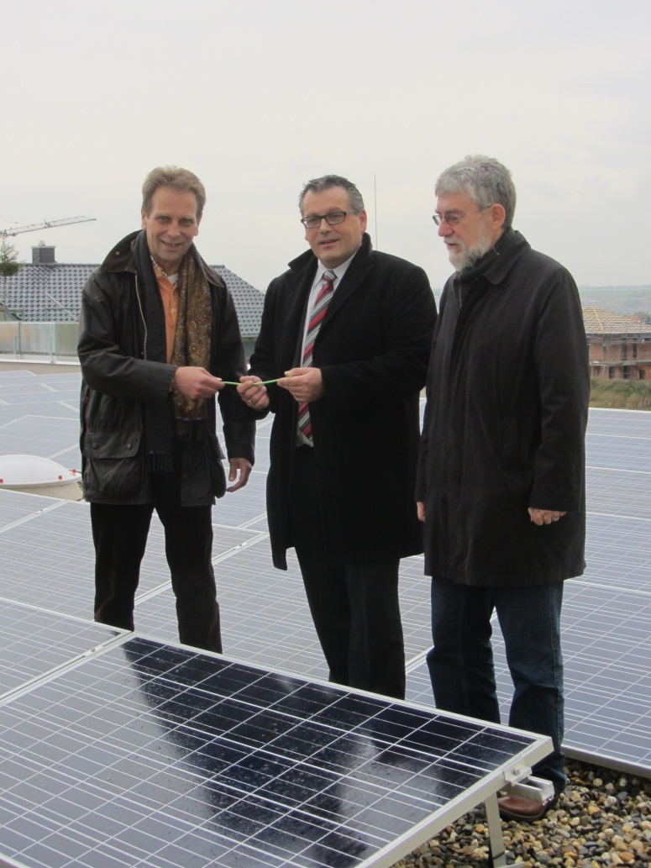
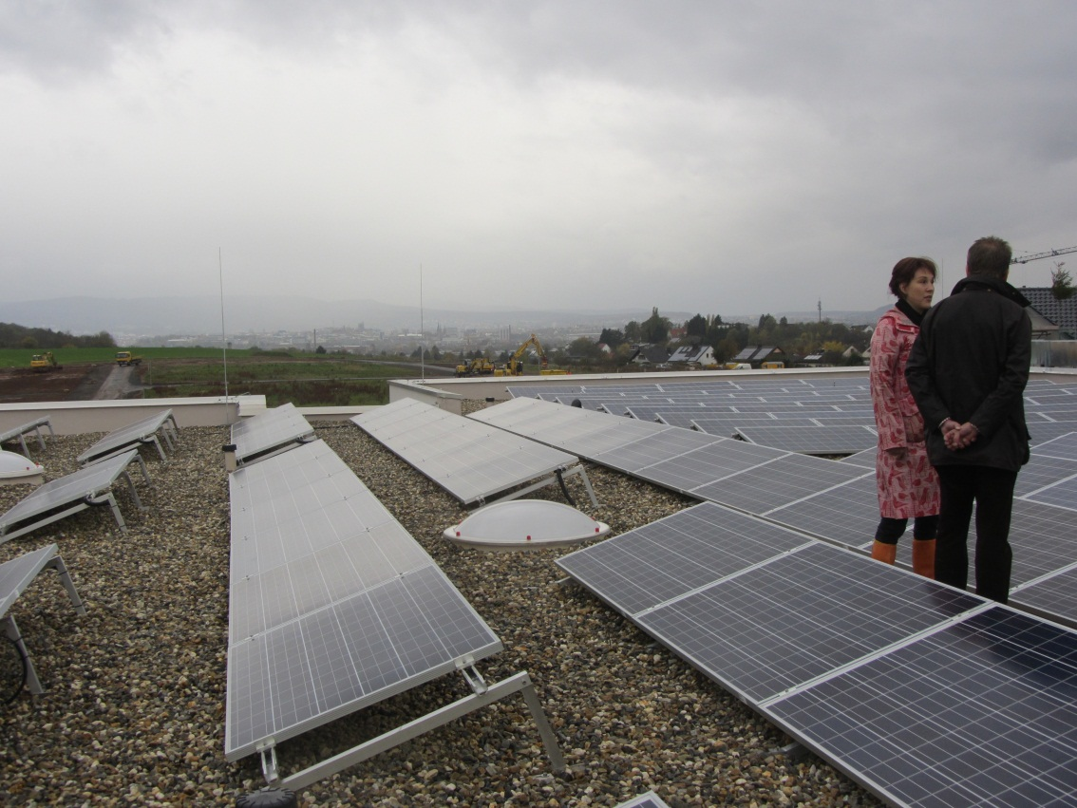
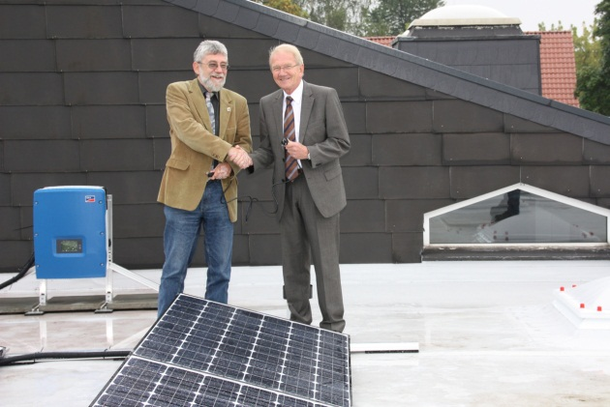
Transfer of pv-plants to the mayors

Slide 19
Soft facts of change agents
the citizen need a face, a contact
they know just a little bit on the subject, are unable to cope
they need someone who guides them and take them by the hand in the literal sense
they guide them through the different steps, one after the other
for this they will be loved and there is a very good word-of-mouth - propaganda
they need someone to interconnect possible actors, just to get in action
Conclusion: the change agent must be loyalty, integrity, reliable and independent of commercial interests

Slide 20
Thanks a lot for your attention!
www.klimaschutz-niestetal.de

