Slide 1
A critical review on the REMIX policy paper input of Austria
Dr Wolfgang Reimer, GKZ - 26 June 2017 REMIX Workshop Leoben, Austria

Slide 2
From the REMIX proposal
Smart and Green Mining Regions of EU (REMIX) dealing with the topic, currently hampering the growth of the industry in EU
REMIX encourages the regions to develop the policy practices and instruments to advance establishment of the regional industrial value chains in the mining involving large and small scale actors to generate more growth and jobs.
in order to develop synergic approaches, which will boost EU competitiveness and stimulates sustainable development,
Growth and Jobs and new SME industries
Improved framework conditions at regional level are leading to a more transparent and secure environment for investments

Slide 3
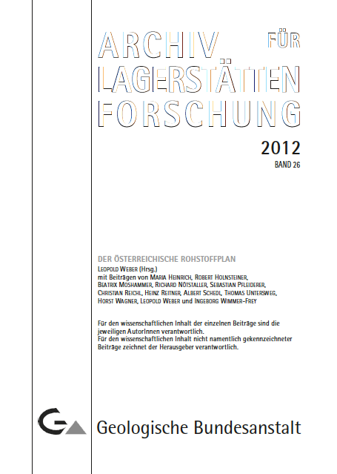
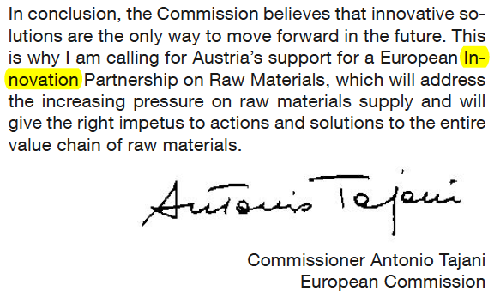
→ In the entire Austrian Mineral Resources Plan there is no single world about:„smart“ „specialisation“ „innovation“, except in the preface (reference is made to European Innovation Partnership on Raw Materials)

Slide 4
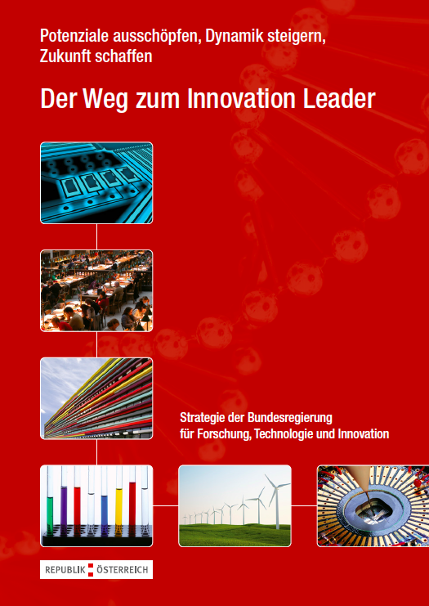
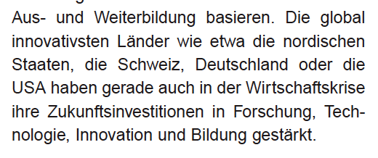
Austrian Innovation Strategy
„Innovation drivers“: investment in:
research, technology, innovation and
Education.

Slide 5
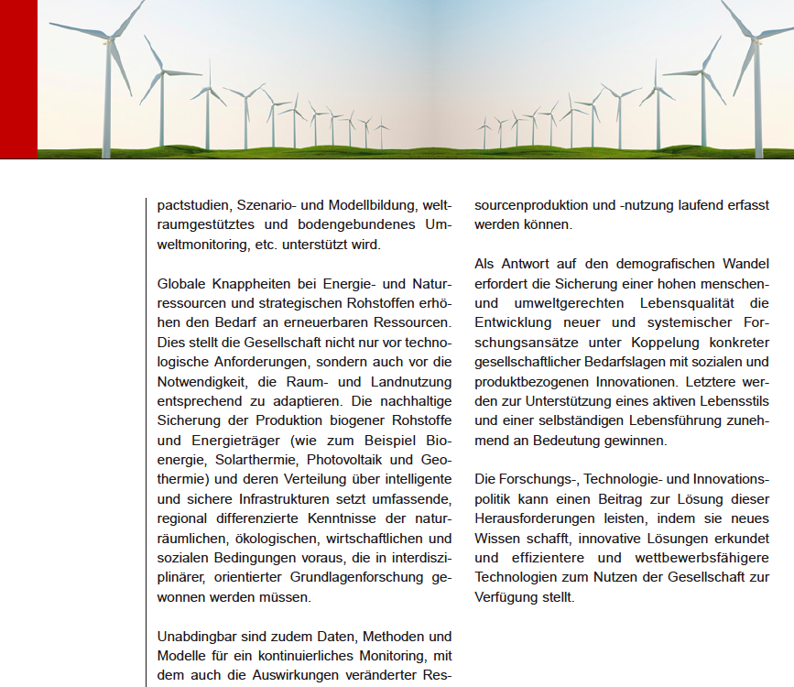
....in the entire document there is no single word on „mining“, „raw materials“;
only: biogene natural resources!

Slide 6
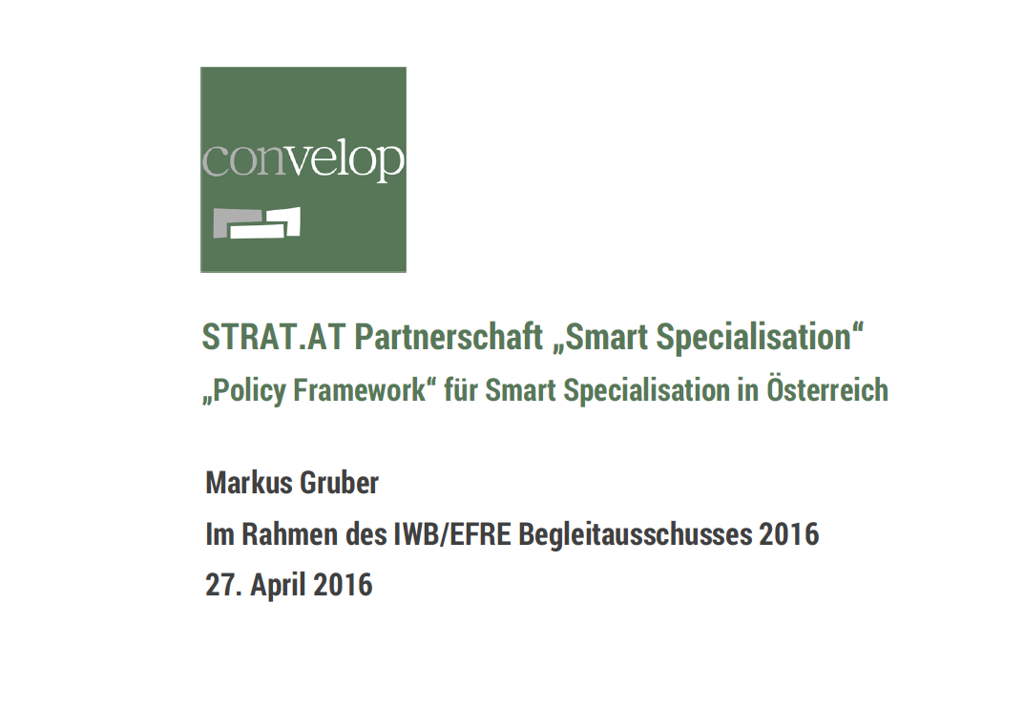
Smart specialisation is ancored in the RIS3 Policy Framework

Slide 7
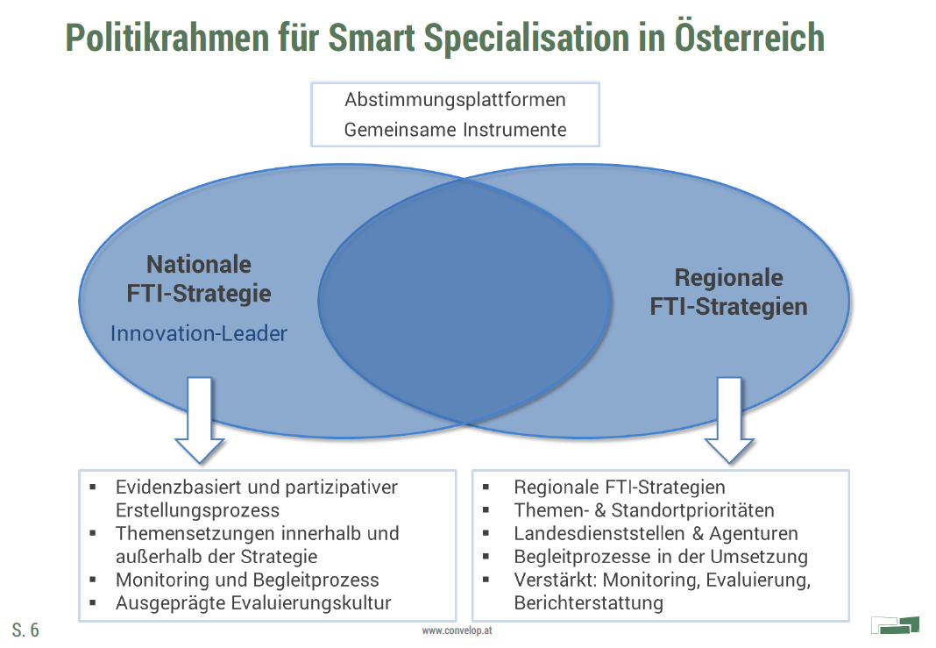
...and this is splitted into the National Strategy and the Regional Strategies

Slide 9
The Regional Strategies have a strong focus on „energy“, „environment“, „climate“ and „raw materials“ as part of
→ Sustainability
However, it seems that „raw materials“ are being „included“ in the other subjects rather as a minor issue. A similar situation like the → societal challenges of raw material related Horizon 2020 issues

Slide 10
Styria´s Regional Strategy elevates „materials technologies and links
it to engineering, process and electronics. They stand at the closest to
raw materials.

Slide 11
Austria´s RIS3 chart,
In capabilities „mining“ stands closest – if so – to manufactoring; but no further
Specification is made, for instance how to valorise the intense metallurgical
know-how of the country.

Slide 12
Glück Auf!
Questions welcome

